Slide 1
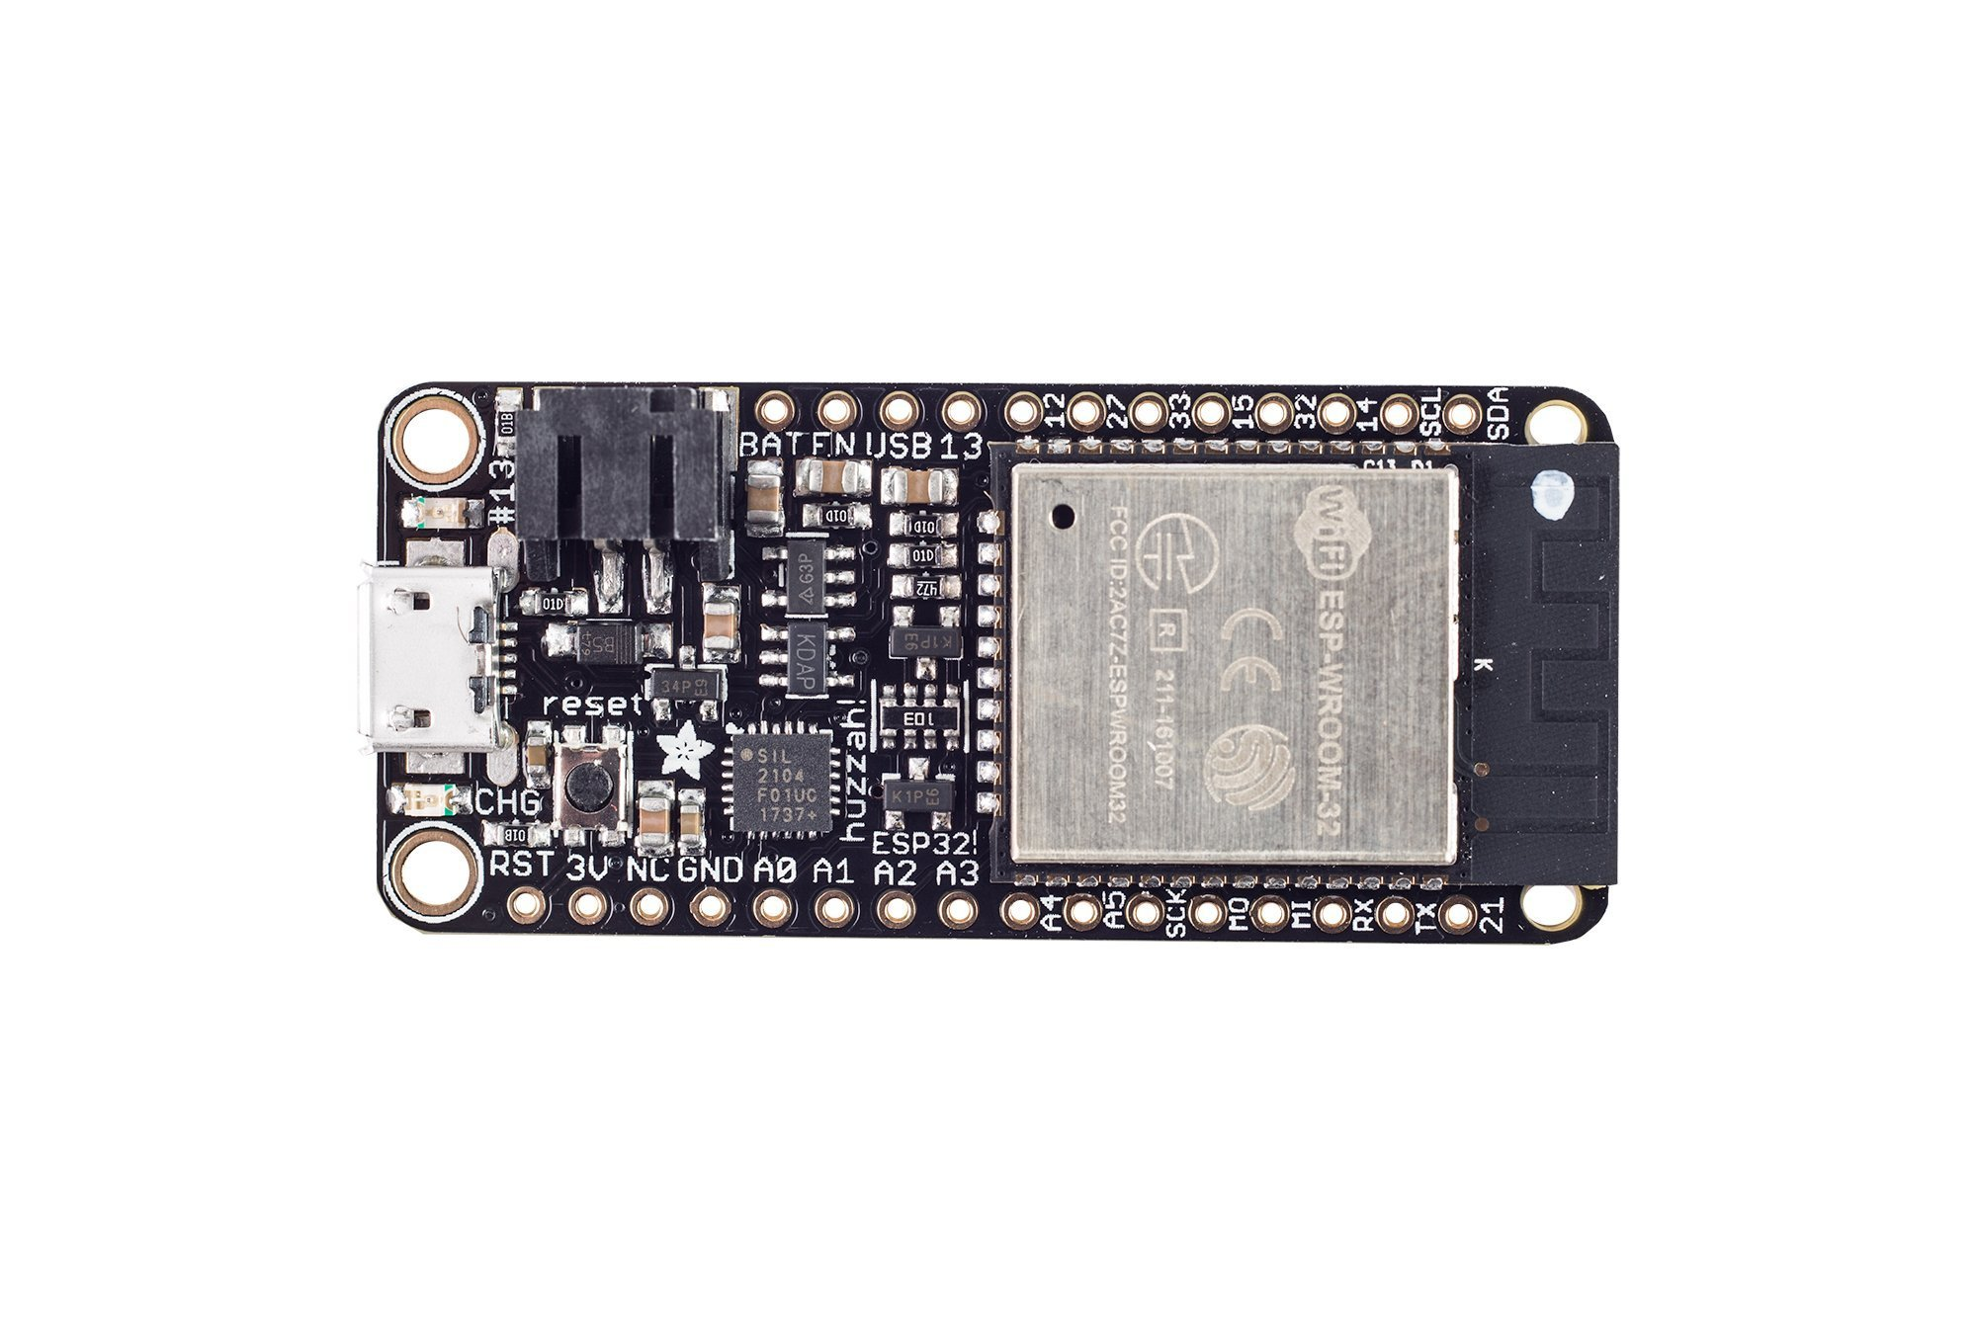

Slide 2
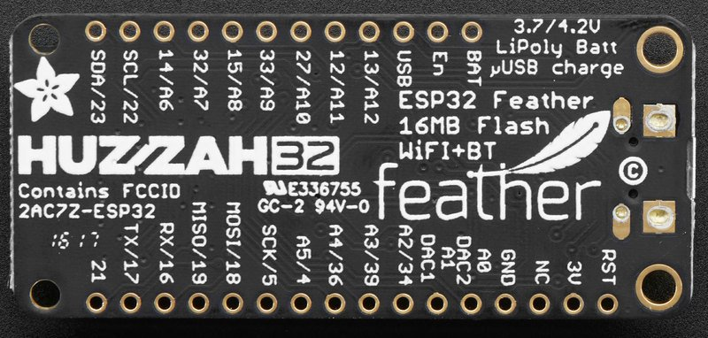
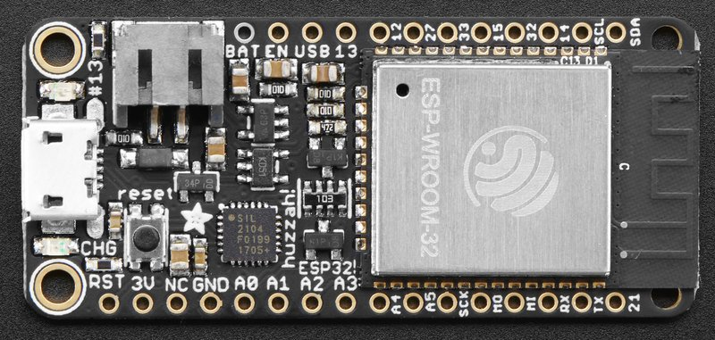

Slide 3


GPIO #23
GPIO #21
GPIO #22
GPIO #17
A6 ADC#2
GPIO #14
GPIO #16
A7 ADC#1
GPIO #32
GPIO #19
A8 ADC#2
GPIO #15
GPIO #18
A9 ADC#1
GPIO #33
GPIO #5
A10 ADC#2
GPIO #27
GPIO #4
A5 ADC#2
A11 ADC#2
GPIO #12
GPI #36
A4 ADC#1
A12 ADC#2
GPIO #13
GPI #39
A3 ADC#1
Positive voltage from USB jack, if connected. ~5V
GPI #34
A2 ADC#1
Drive LOW to disable 3.3V regulator
GPIO #25
A1 ADC#2
Positive voltage from LiPoly battery, if connected. ~3.7V
GPIO #26
A0 ADC#2
Common ground for power and logic
No connect pin (not used)
3.3V output from on-board regulator. Can supply up to 500mA.
Drive LOW to reset (or press Reset button)
Notes:
https://people.eecs.berkeley.edu/~boser/courses/49_sp_2019/N_gpio.html

Slide 4
A13 not exposed. It’s used for measuring the voltage on the battery. The voltage is divided by 2 so multiply the analogRead by 2.
I2C SDA
GPIO #23
GPIO #21
GPIO#12 Used for booting up. Adafruit suggests not using it or only using for output.
I2C SCL
GPIO #22
GPIO #17
A6 ADC#2
GPIO #14
GPIO #16
You can only read analog inputs on ADC#1 once WiFi has started
A7 ADC#1
GPIO #32
GPIO #19
SPI MISO
PWM is possible on every GPIO pin
A8 ADC#2
GPIO #15
GPIO #18
SPI MOSI
A9 ADC#1
GPIO #33
GPIO #5
SPI SCK
A10 ADC#2
GPIO #27
GPIO #4
A5 ADC#2
A11 ADC#2
GPIO #12
GPI #36
A4 ADC#1
A12 ADC#2
GPIO #13
GPI #39
A3 ADC#1
Positive voltage from USB jack, if connected. ~5V
GPI #34
A2 ADC#1
Drive LOW to disable 3.3V regulator
GPIO #25
A1 ADC#2
DAC1
Positive voltage from LiPoly battery, if connected. ~3.7V
GPIO #26
A0 ADC#2
DAC2
Common ground for power and logic
No connect pin (not used)
3.3V output from on-board regulator. Can supply up to 500mA.
Drive LOW to reset (or press Reset button)
Notes:
https://people.eecs.berkeley.edu/~boser/courses/49_sp_2019/N_gpio.html
https://learn.adafruit.com/adafruit-huzzah32-esp32-feather/pinouts

Slide 5
Adafruit Huzzah32 Pin Diagram
A13 not exposed. It’s used for measuring the voltage on the battery. The voltage is divided by 2 so multiply the analogRead by 2.
GPIO#12 Used for booting up. Adafruit suggests not using it or only using for output.
You can only read analog inputs on ADC#1 once WiFi has started
PWM is possible on every GPIO pin
I2C SDA
GPIO #23
GPIO #21
I2C SCL
GPIO #22
GPIO #17
A6 ADC#2
GPIO #14
GPIO #16
A7 ADC#1
GPIO #32
GPIO #19
SPI MISO
A8 ADC#2
GPIO #15
GPIO #18
SPI MOSI
A9 ADC#1
GPIO #33
GPIO #5
SPI SCK
A10 ADC#2
GPIO #27
GPIO #4
A5 ADC#2
A11 ADC#2
GPIO #12
GPI #36
A4 ADC#1
A12 ADC#2
GPIO #13
GPI #39
A3 ADC#1
Positive voltage from USB jack, if connected. ~5V
GPI #34
A2 ADC#1
Drive LOW to disable 3.3V regulator
GPIO #25
A1 ADC#2
DAC1
Positive voltage from LiPoly battery, if connected. ~3.7V
GPIO #26
A0 ADC#2
DAC2
GND. Common ground for power and logic
No connect pin (not used)
3.3V output from on-board regulator. Can supply up to 500mA.
Drive LOW to reset (or press Reset button)
By @jonfroehlich
Notes:
https://people.eecs.berkeley.edu/~boser/courses/49_sp_2019/N_gpio.html
https://learn.adafruit.com/adafruit-huzzah32-esp32-feather/pinouts

Slide 6
Adafruit Huzzah32 Pin Diagram
A13 not exposed. It’s used for measuring the voltage on the battery. The voltage is divided by 2 so multiply the analogRead by 2.
GPIO#12 Used for booting up. Adafruit suggests not using it or only using for output.
ADC#2 does not work when WiFi is activated. The ESP32 internally uses ADC#2 for WiFi
PWM is possible on every GPIO pin
I2C SDA
GPIO #23
GPIO #21
I2C SCL
GPIO #22
GPIO #17
TOUCH6
A6 ADC#2
GPIO #14
GPIO #16
TOUCH9
A7 ADC#1
GPIO #32
GPIO #19
SPI MISO
TOUCH3
A8 ADC#2
GPIO #15
GPIO #18
SPI MOSI
TOUCH8
A9 ADC#1
GPIO #33
GPIO #5
SPI SCK
TOUCH7
A10 ADC#2
GPIO #27
GPIO #4
A5 ADC#2
TOUCH0
TOUCH5
A11 ADC#2
GPIO #12
GPI #36
A4 ADC#1
TOUCH4
A12 ADC#2
GPIO #13
GPI #39
A3 ADC#1
Positive voltage from USB jack, if connected. ~5V
GPI #34
A2 ADC#1
Drive LOW to disable 3.3V regulator
GPIO #25
A1 ADC#2
DAC1
Positive voltage from LiPoly battery, if connected. ~3.7V
GPIO #26
A0 ADC#2
DAC2
GND. Common ground for power and logic
No connect pin (not used)
3.3V output from on-board regulator. Can supply up to 500mA.
Drive LOW to reset (or press Reset button)
By @jonfroehlich
Notes:
https://people.eecs.berkeley.edu/~boser/courses/49_sp_2019/N_gpio.html
https://learn.adafruit.com/adafruit-huzzah32-esp32-feather/pinouts

Slide 7
I2C SDA
GPIO #23
GPIO #21
I2C SCL
GPIO #22
GPIO #17
A6 ADC#2
GPIO #14
GPIO #16
A7 ADC#1
GPIO #32
GPIO #19
SPI MISO
A8 ADC#2
GPIO #15
GPIO #18
SPI MOSI
A9 ADC#1
GPIO #33
GPIO #5
SPI SCK
A10 ADC#2
GPIO #27
GPIO #4
A5 ADC#2
A11 ADC#2
GPIO #12
GPI #36
A4 ADC#1
A12 ADC#2
GPIO #13
GPI #39
A3 ADC#1
Positive voltage from USB jack, if connected. ~5V
GPI #34
A2 ADC#1
Drive LOW to disable 3.3V regulator
GPIO #25
A1 ADC#2
DAC1
Positive voltage from LiPoly battery, if connected. ~3.7V
GPIO #26
A0 ADC#2
DAC2
GND. Common ground for power and logic
No connect pin (not used)
3.3V output from on-board regulator. Can supply up to 500mA.
Drive LOW to reset (or press Reset button)
By @jonfroehlich
Notes:
https://people.eecs.berkeley.edu/~boser/courses/49_sp_2019/N_gpio.html
https://learn.adafruit.com/adafruit-huzzah32-esp32-feather/pinouts

Slide 8
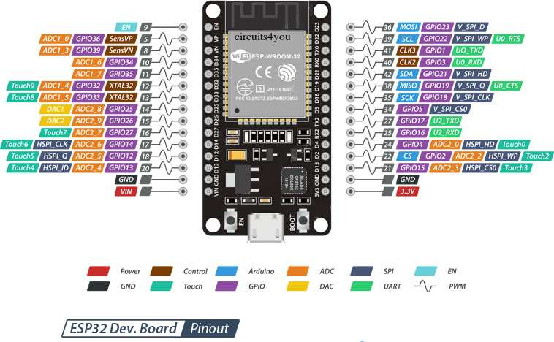

Slide 9
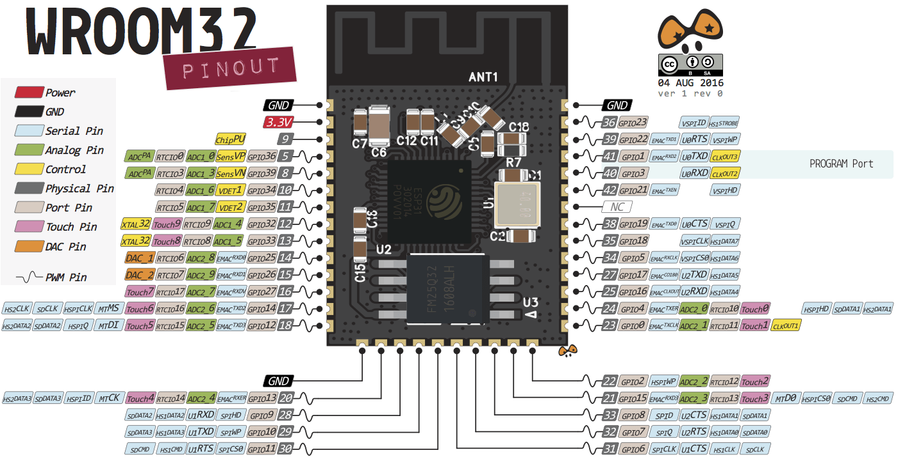

Slide 10
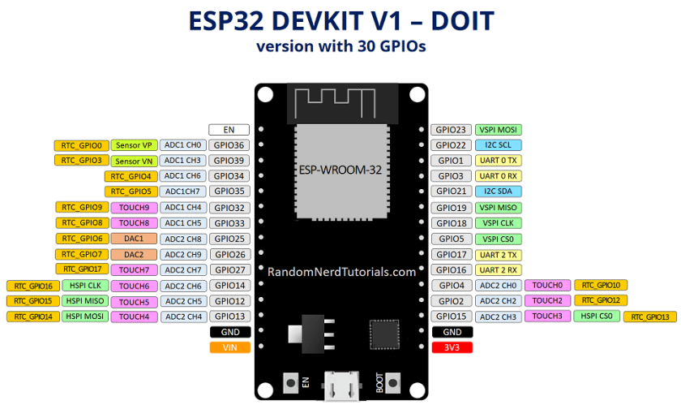

Slide 11
Redbear duo: pIN lAYOUT
arduino
I’ve simplified the pin layout chart and flipped it around (I tend to program with the USB facing away from me)
3.5-8V
VIN
3.3V
GND
RST
PWM12
TX
D17
VBAT
PWM11
RX
D16
GND
WKP
PWM10
A7
D15
D7
LED
PWM9
A6
D14
D6
PWM8
A5
D13
D5
PWM5
PWM7
A4
D12
D4
PWM4
DAC2
A3
D11
D3
PWM3
DAC1
A2
D10
D2
PWM2
PWM6
A1
D9
D1
PWM1
PWM5
A0
D8
D0
PWM0
Legend
AX
Analog Input Pin
DX
Digital Input/output Pin
PWM
Supports Analog Out via Pulse Width Modulation
Modified from: https://github.com/redbear/Duo/blob/master/docs/duo_introduction.md

Slide 12
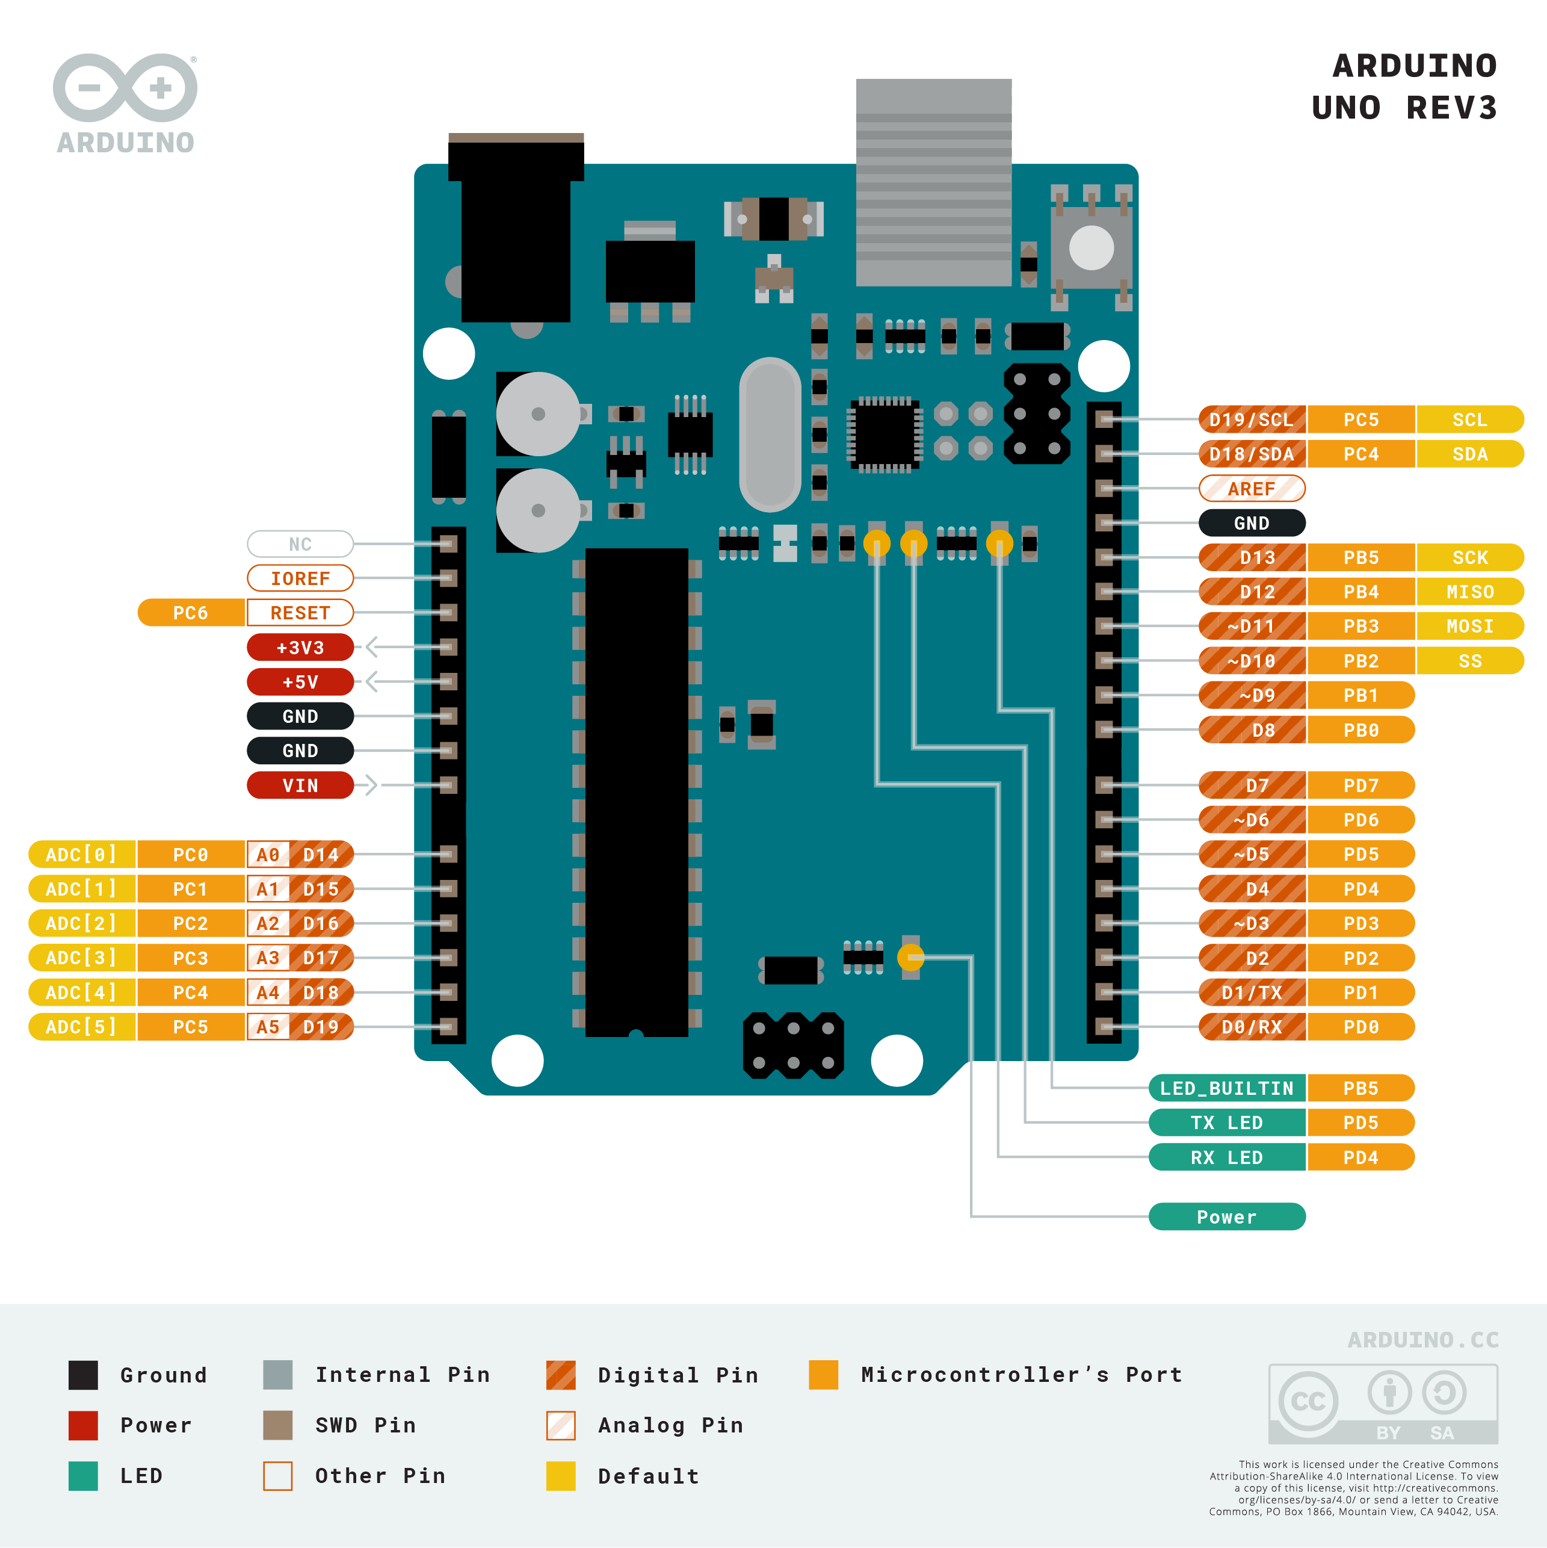

Slide 13
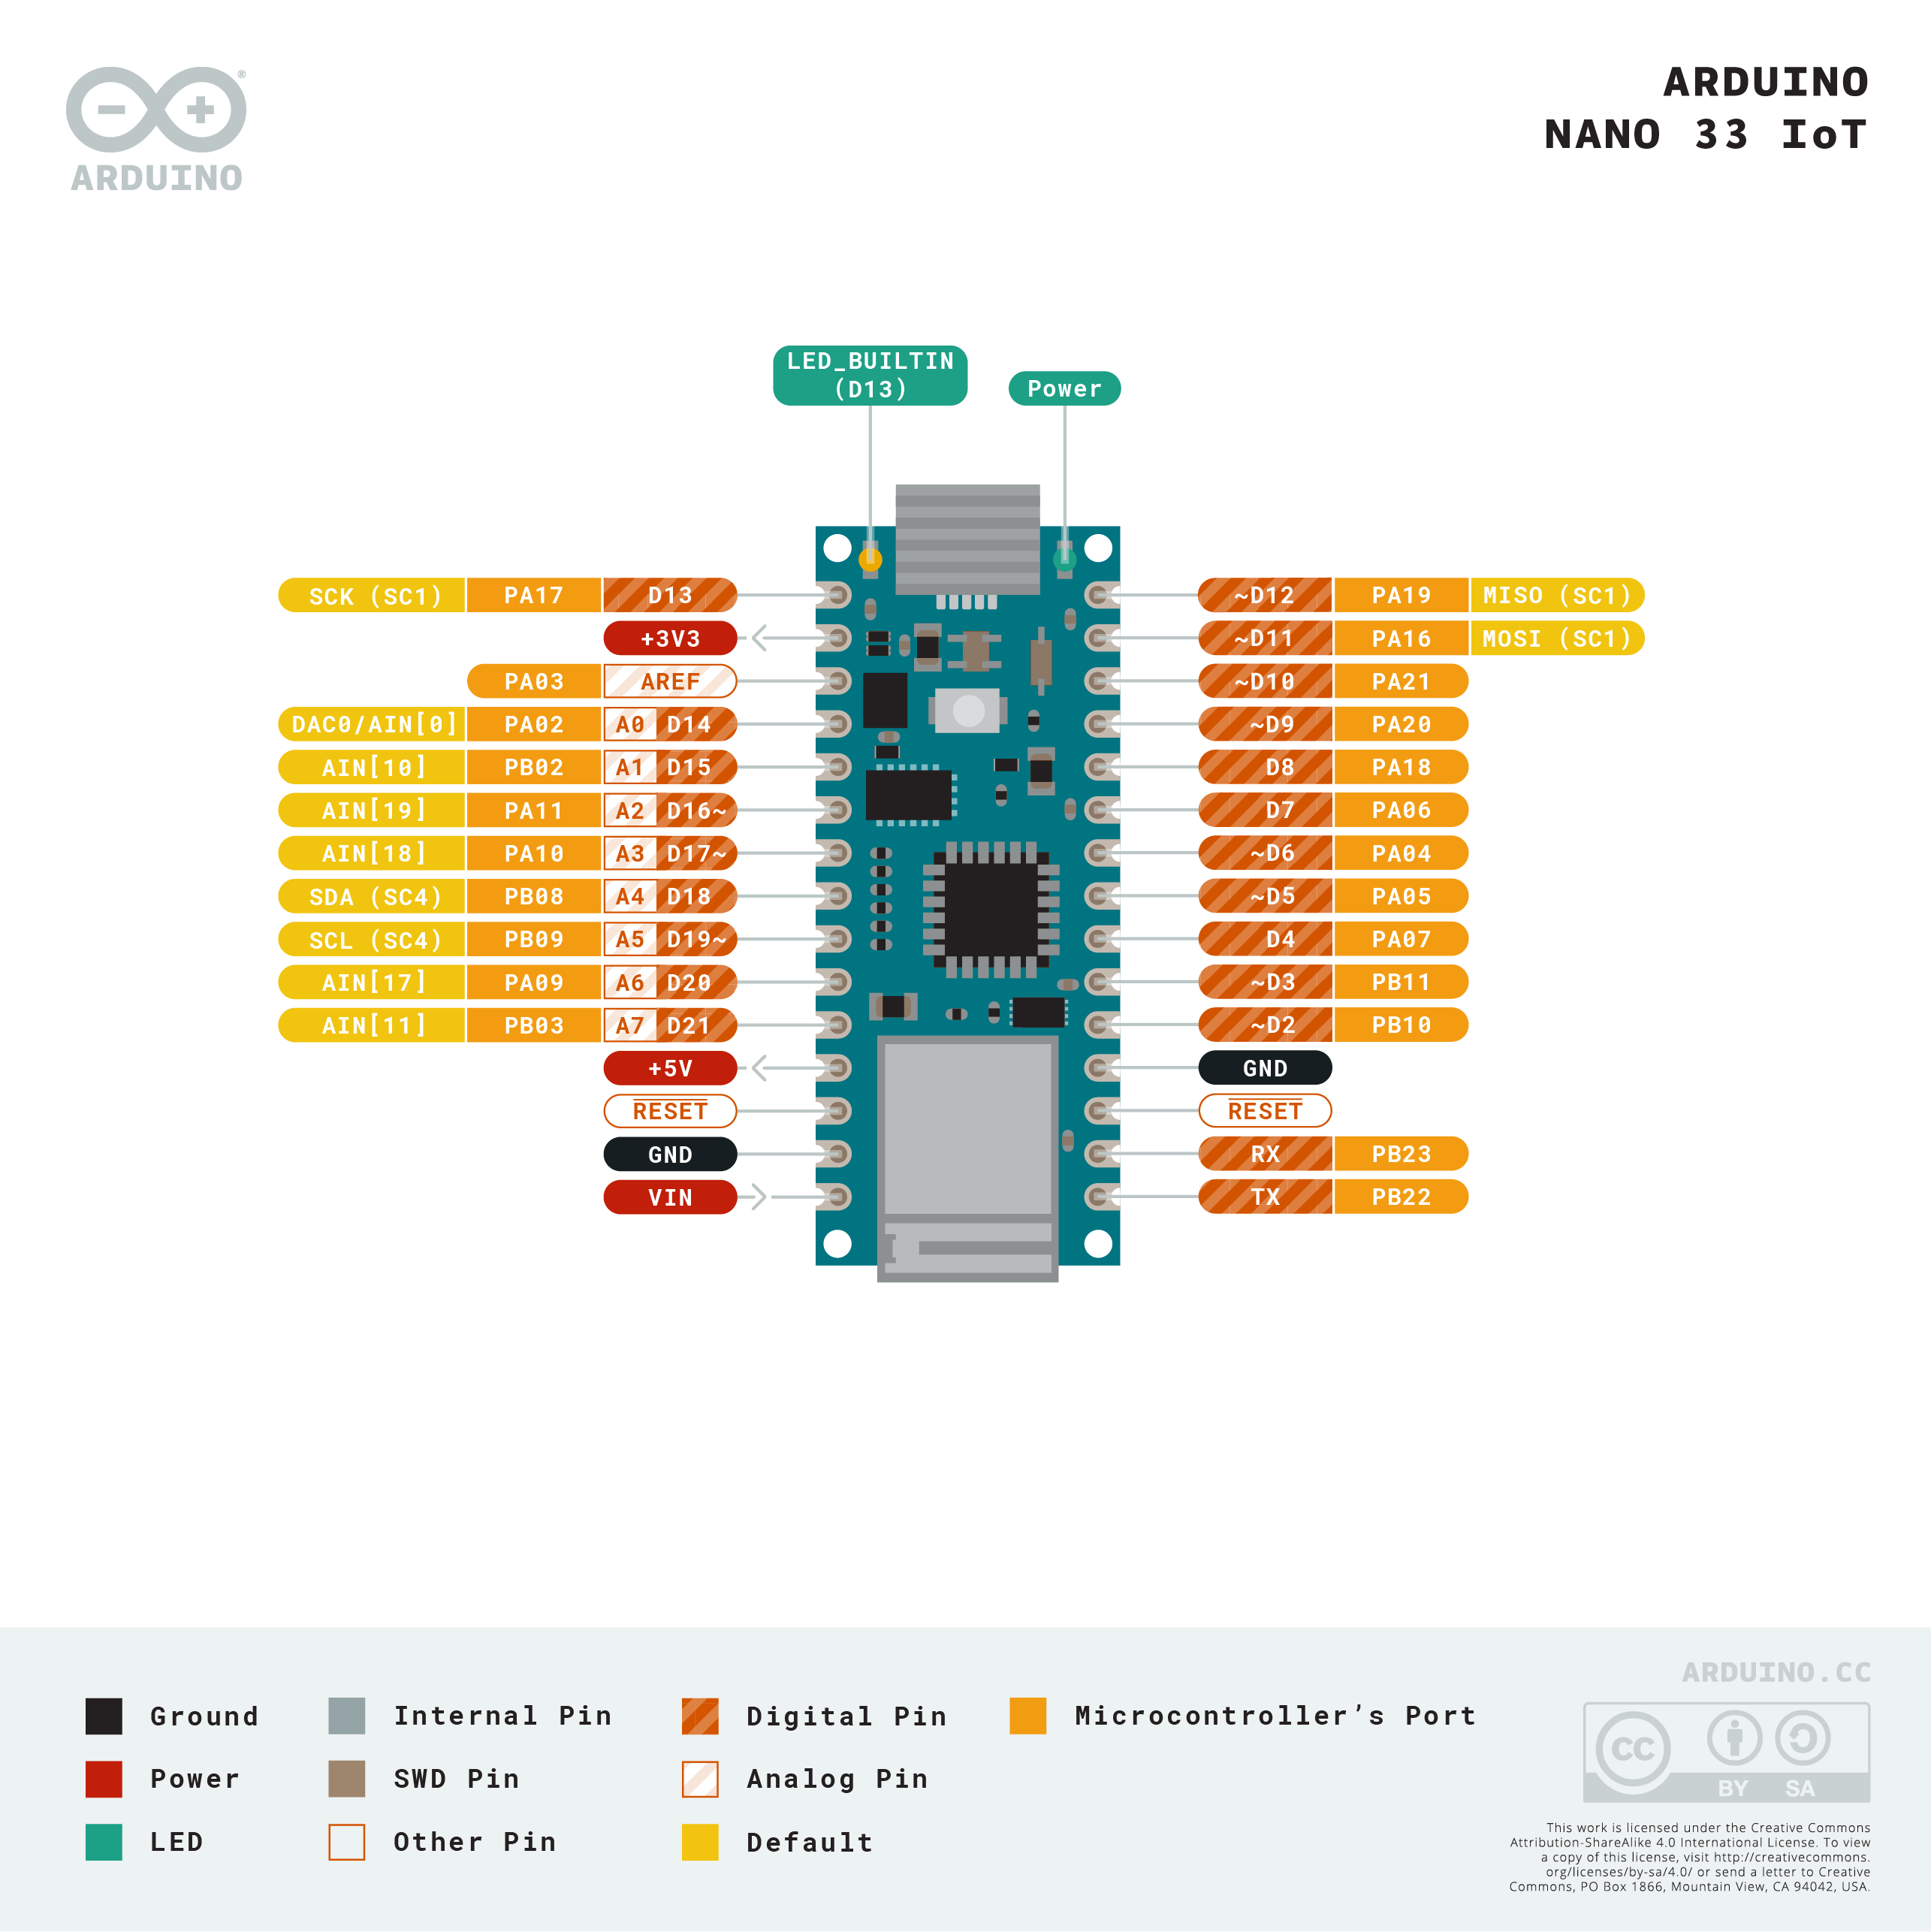

Slide 14
